Slide 1
Accuracy of extinction rate estimates using state-dependent diversification models with fossil data
Bruno do Rosario Petrucci and Tracy A. Heath
Ecology, Evolution, and Organismal Biology – Iowa State University

Slide 2

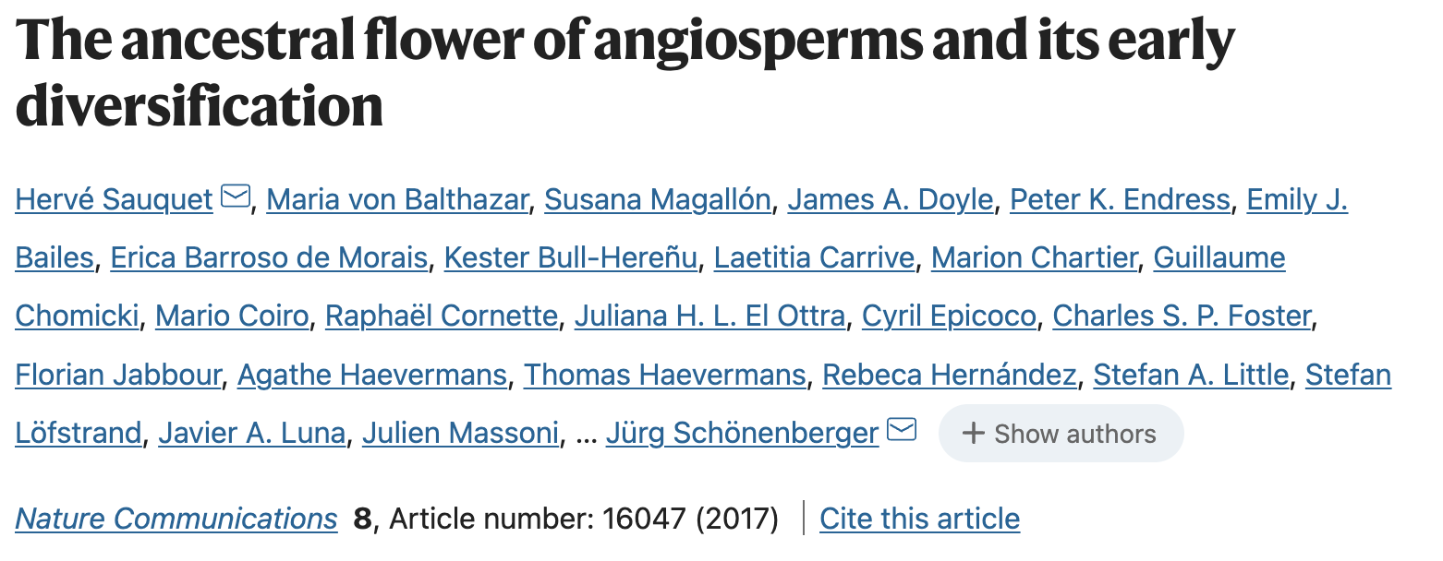
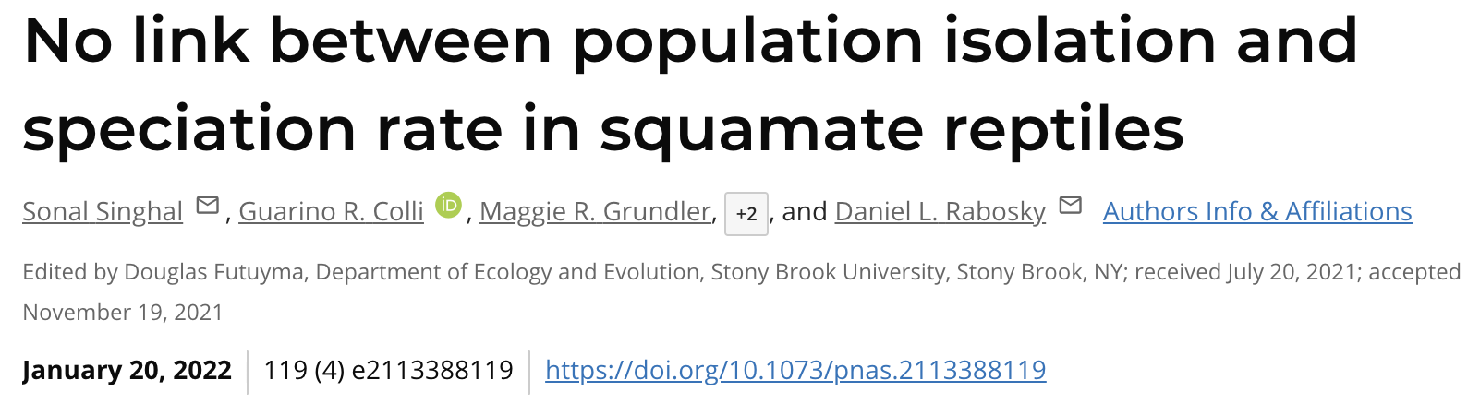
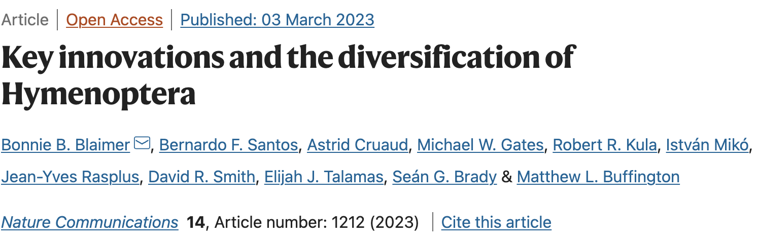
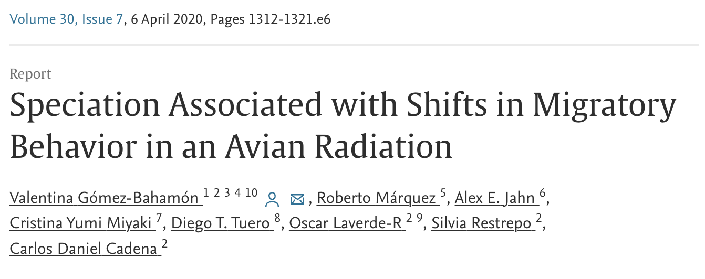
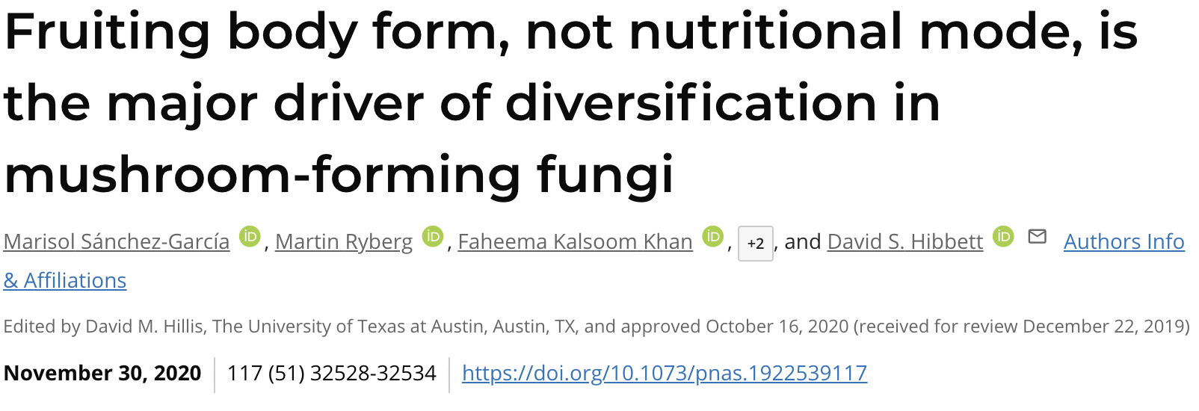
How do traits affect diversification?
Notes:
Questions about how traits affect species diversification are ubiquitous
Examples in fish, angiosperms, reptiles, insects, birds, fungi
To answer these questions, we need statistical models that can estimate the degree to which diversification rates are affected by traits, and we need simulation studies to evaluate these models, and how their accuracy changes with the complex interactions between parameters and data.

Slide 3
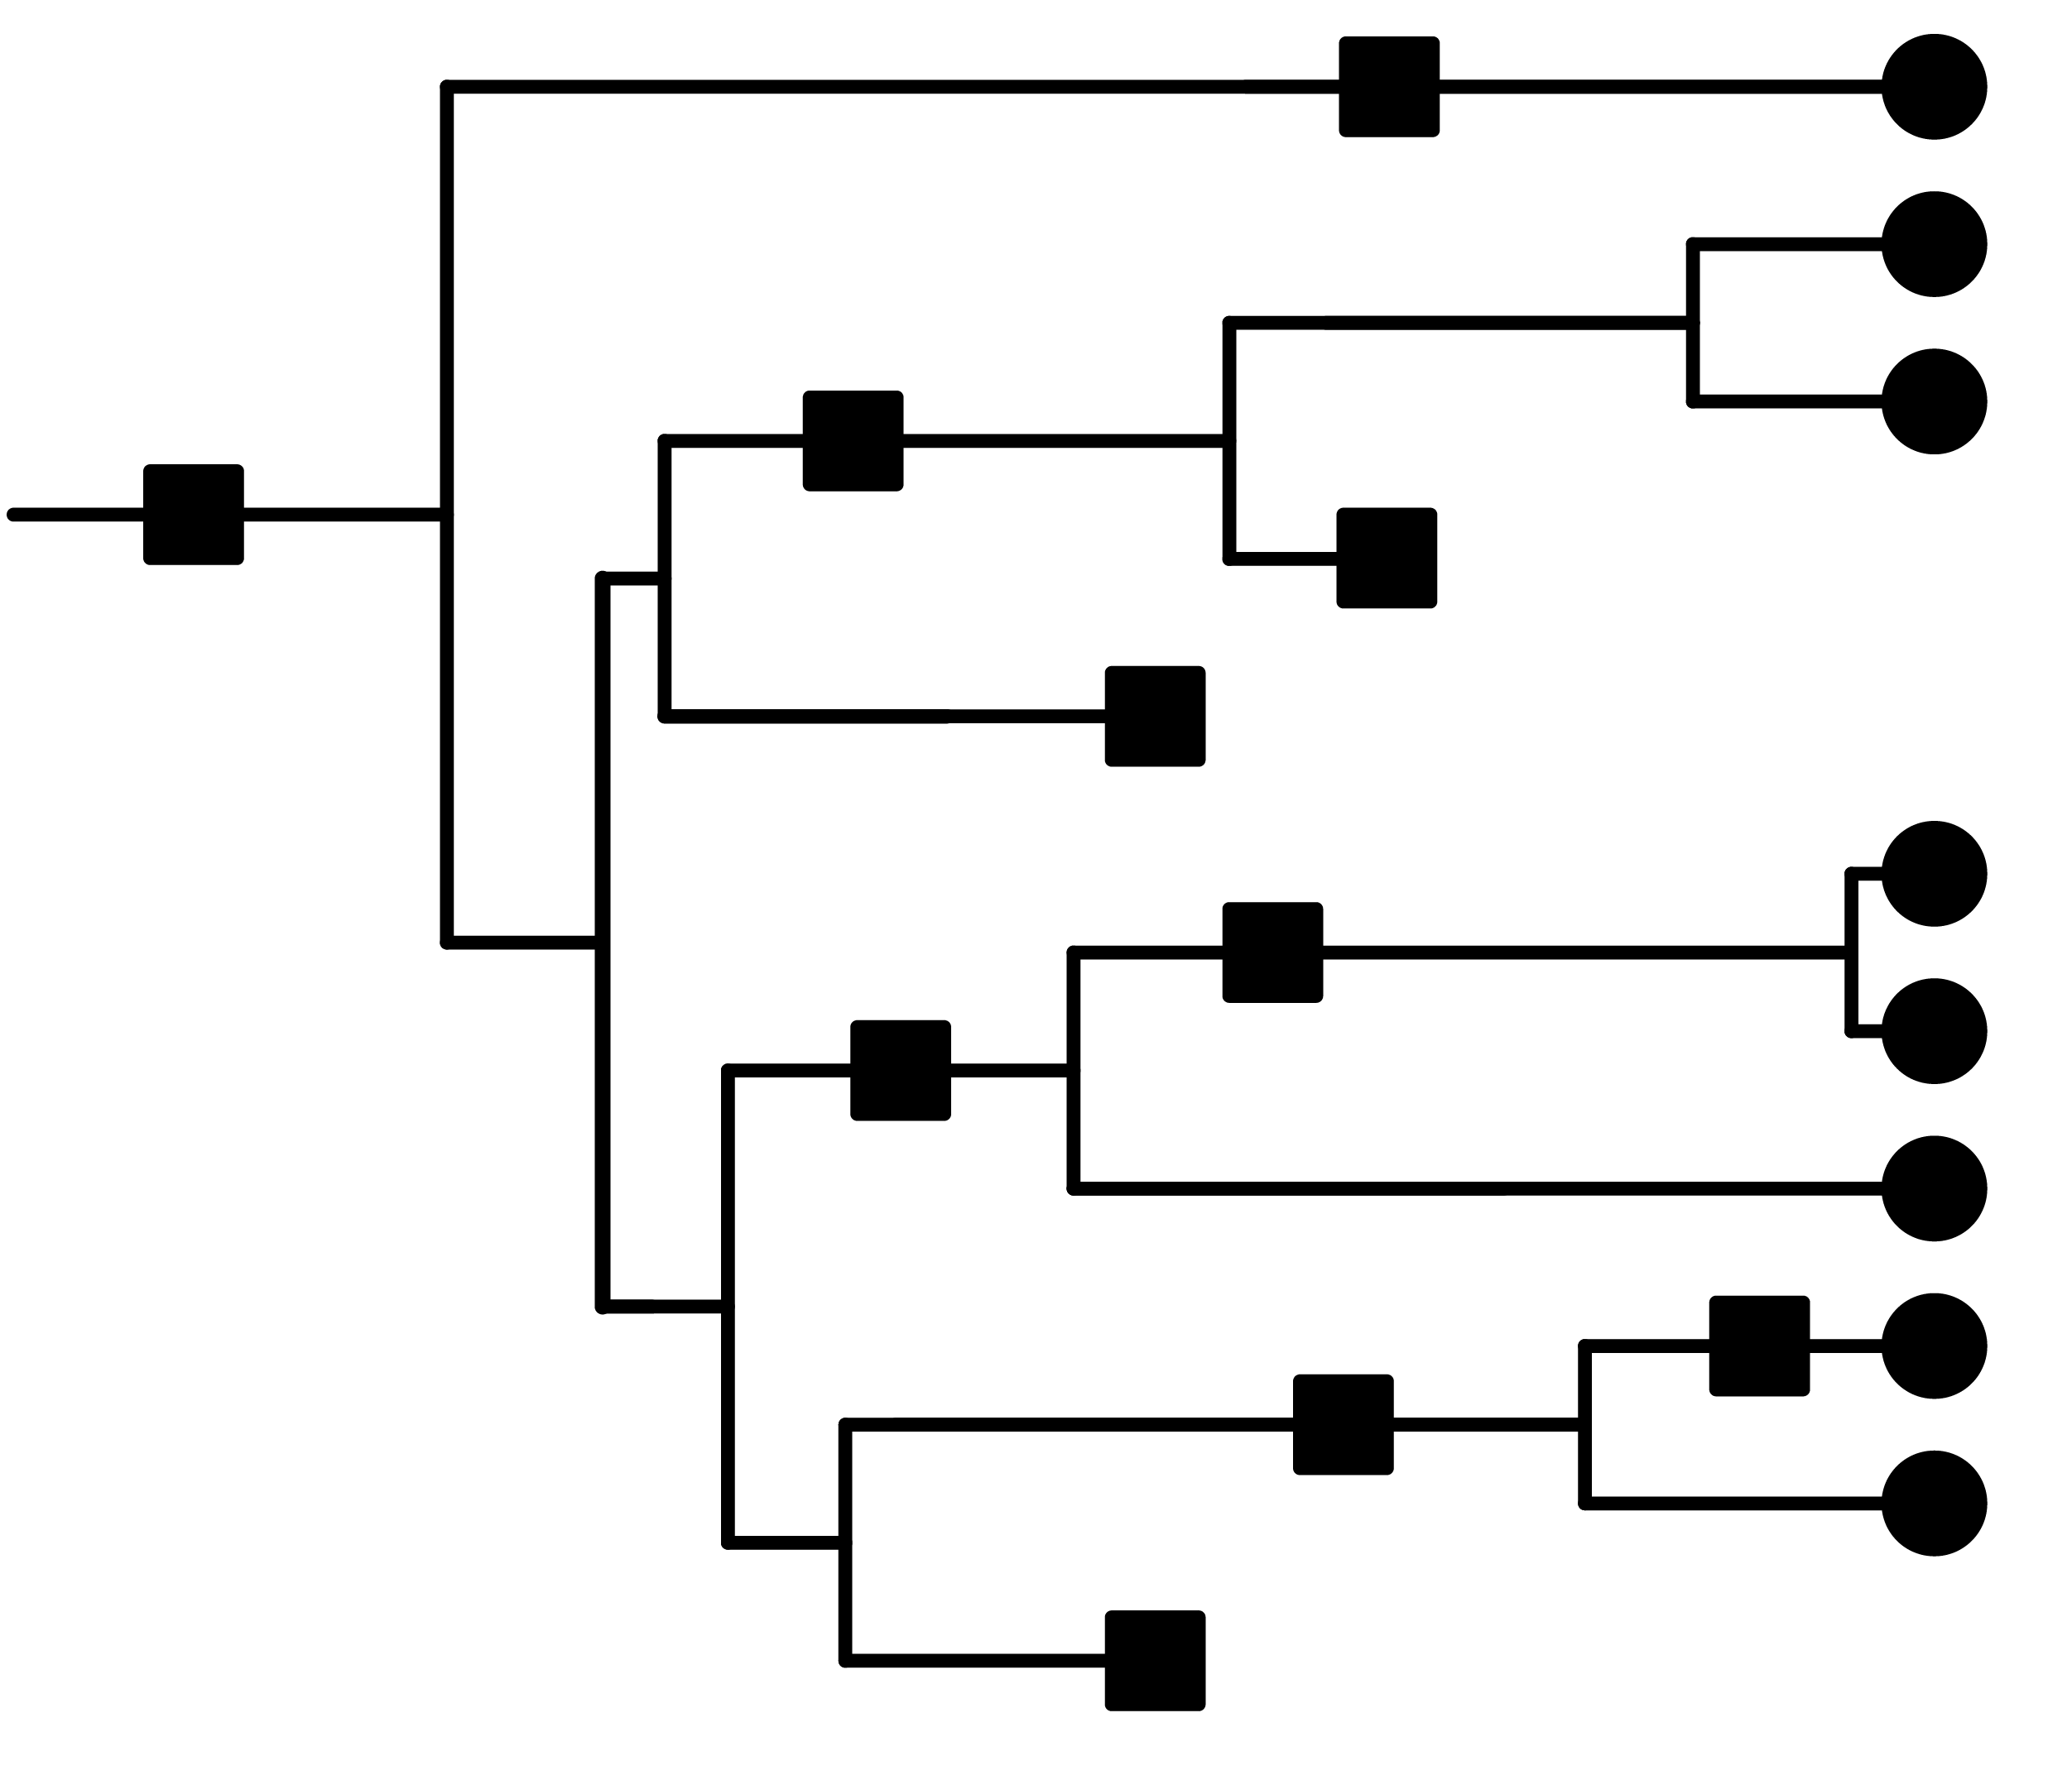
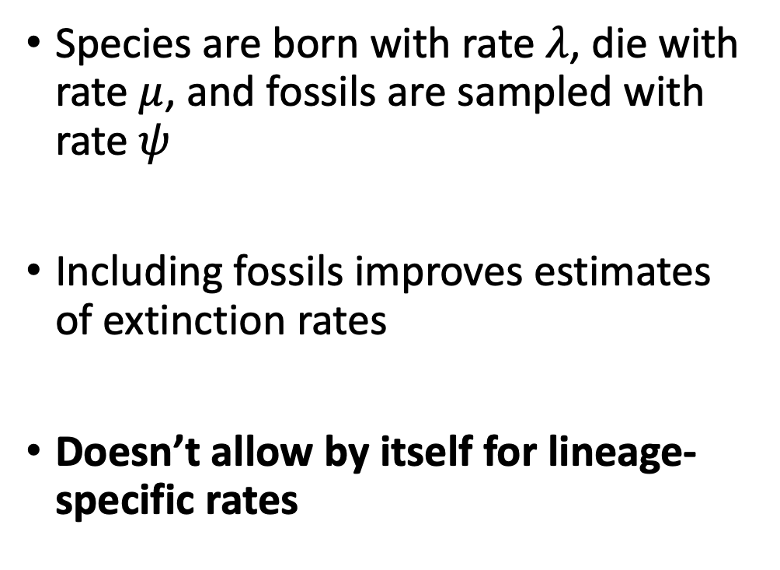
The fossilized birth-death model family
Species are born with rate $λ$, die with rate $μ$, and fossils are sampled with rate $ψ$
Including fossils improves estimates of extinction rates
Doesn’t allow by itself for lineage-specific rates
Illustration by Lucy Hiegata (https://hiegata.myportfolio.com/)
Stadler 2010, Heath et al 2014
Notes:
The first model family we’ll talk about is the fossilized birth-death (FBD) family
In this model, species originate with some rate lambda, go extinct with some rate mu, and leave fossil samples with some rate psi
This tree exemplifies the result of this model: after some time defined by our rates a species might originate, or go extinct, or leave a fossil sample, resulting in the branching pattern with occasional fossil occurrences
BD models have been popular for a long time, but FBD was shown to improve estimates of extinction rates when compared to models using only extant samples. It is therefore a prime candidate for anyone looking to understand the past diversification history of a group
There’s many possible ways to extend FBD, but today we’ll focus on one particular one: the original model doesn’t allow for lineage-specific rates, such as trait-dependent ones
Maybe cut this, explain BD models in the next one, and just mention FBD on the following slide

Slide 4
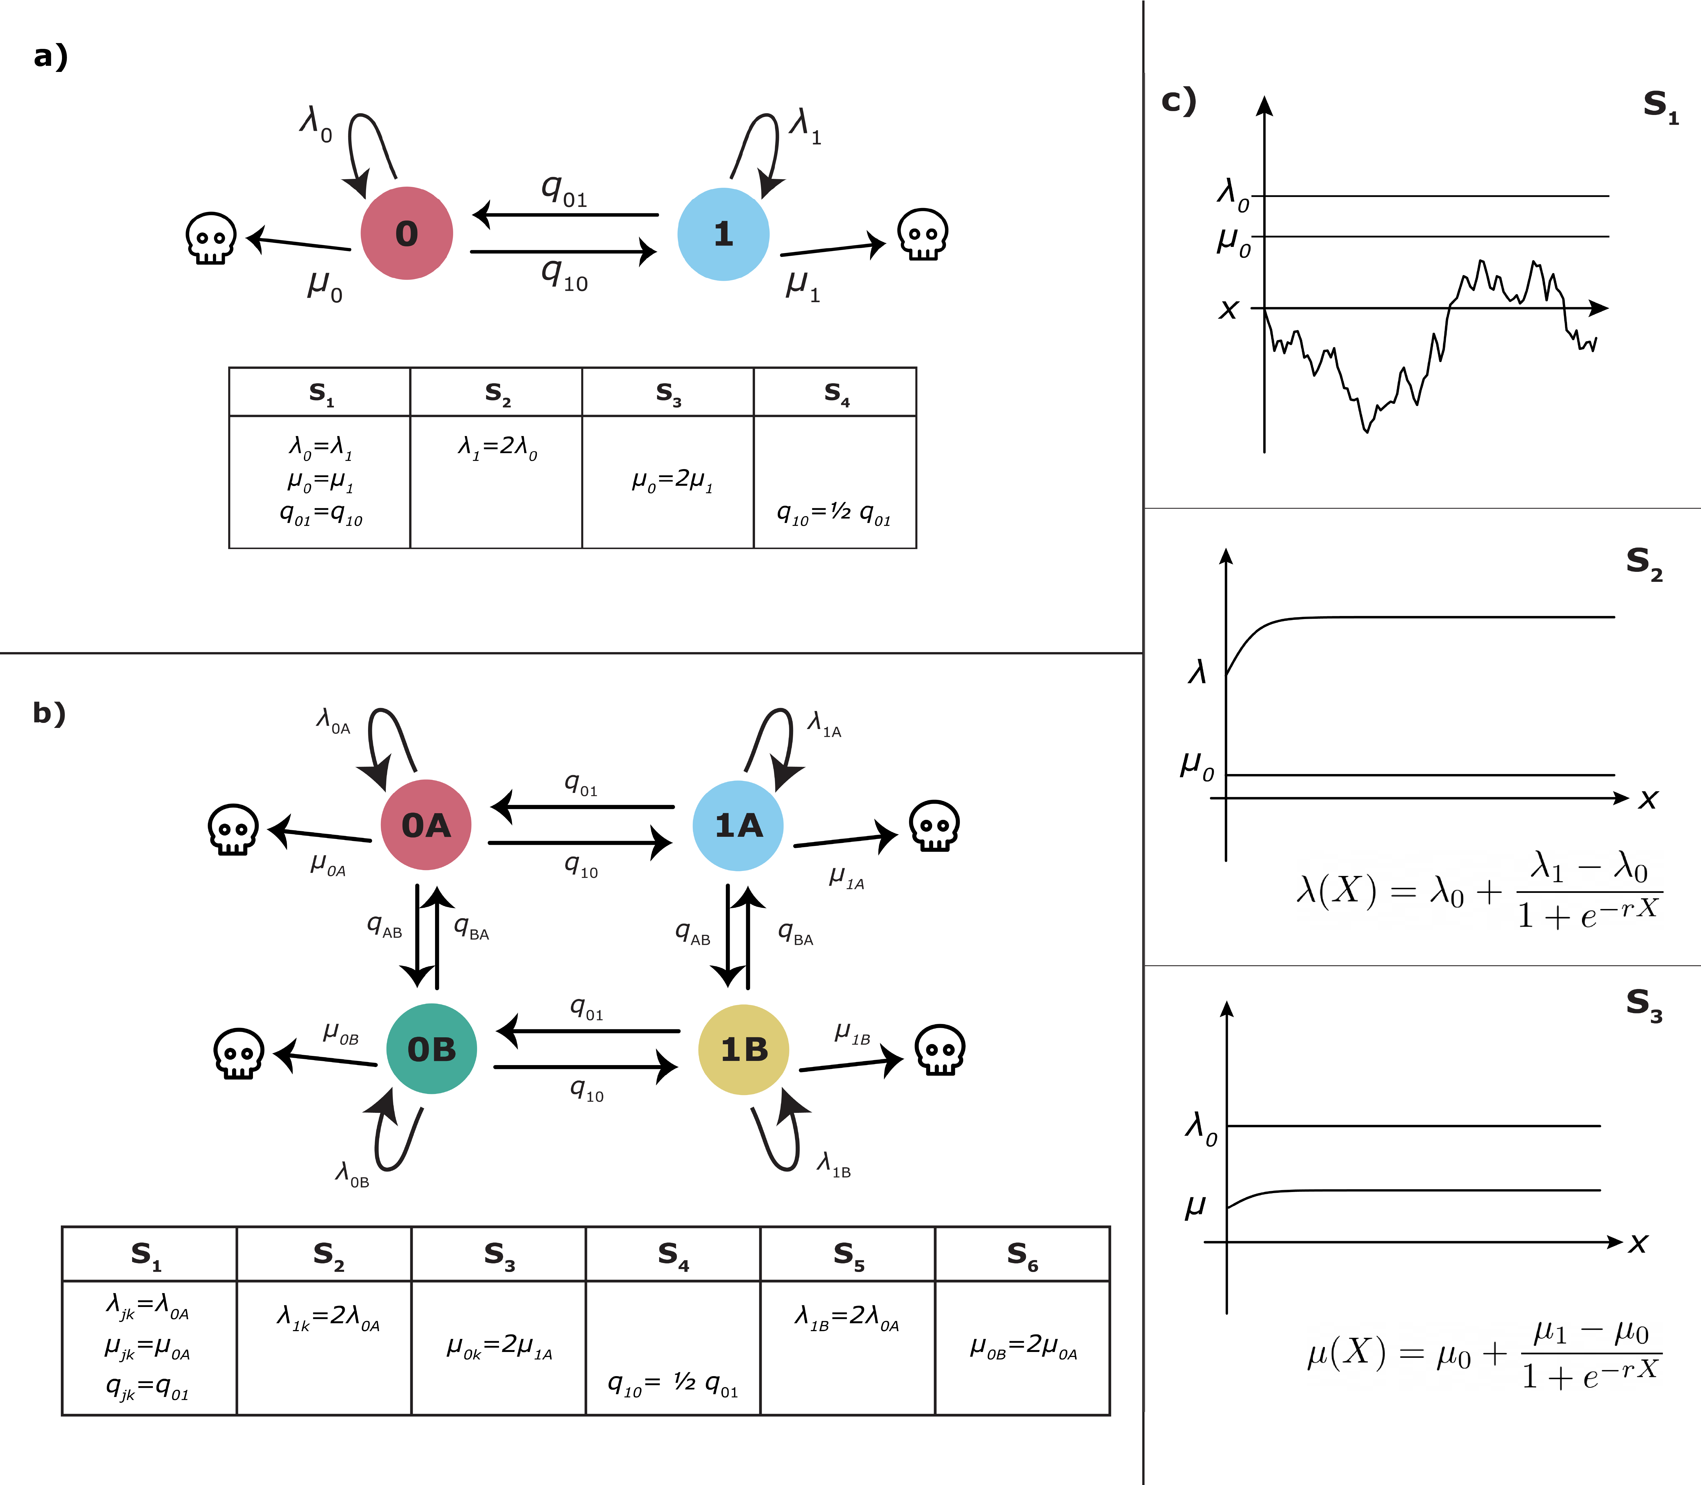
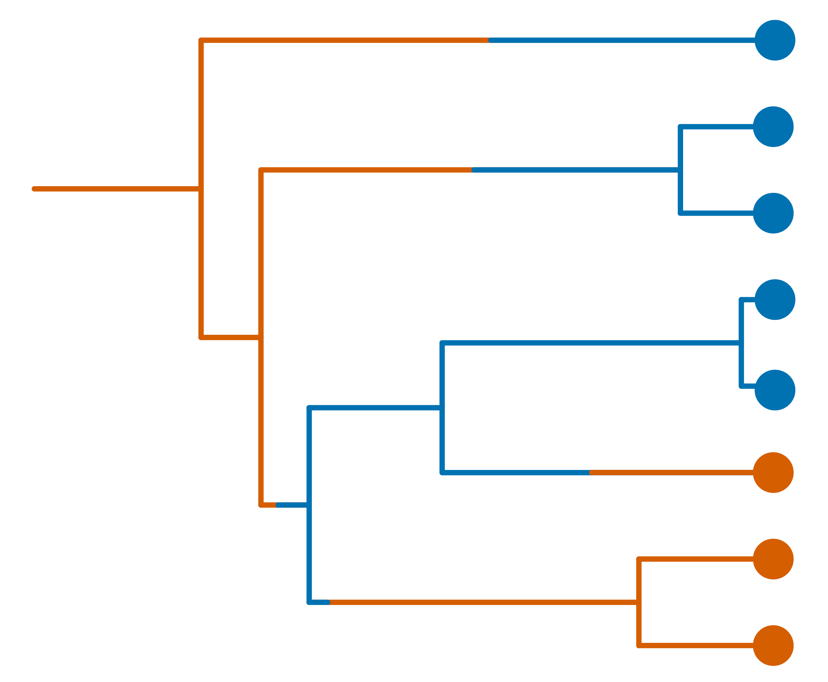
State-dependent speciation and extinction (SSE)
Binary SSE (BiSSE): a binary state controls diversification rates
Historically has (mostly) only been used with extant-only trees
Illustrations by Lucy Hiegata (https://hiegata.myportfolio.com/)
Maddison, Wayne P., Peter E. Midford, and Sarah P. Otto. "Estimating a binary character's effect on speciation and extinction." Systematic biology 56.5 (2007): 701-710.
Notes:
The most common model family for tackling these questions is the SSE model family, a type of birth-death model
Here we have a diagram exemplifying the first iteration, Binary SSE (BiSSE) first published in Maddison et al 2007
Lineages have some trait that takes on 0 1 values, and may transition between those states with rates q01, q10
Lineages at state 0 have speciation rate lambda0, extinction rate mu0, and equivalently for state 1
A realization of that model is the tree here, with lineages changing between the red and blue states and their corresponding rates, until we sample the traits in the present
BiSSE has historically mostly used with extant-only trees, which we know from a multitude of papers may make estimates of extinction rates unreliable

Slide 5
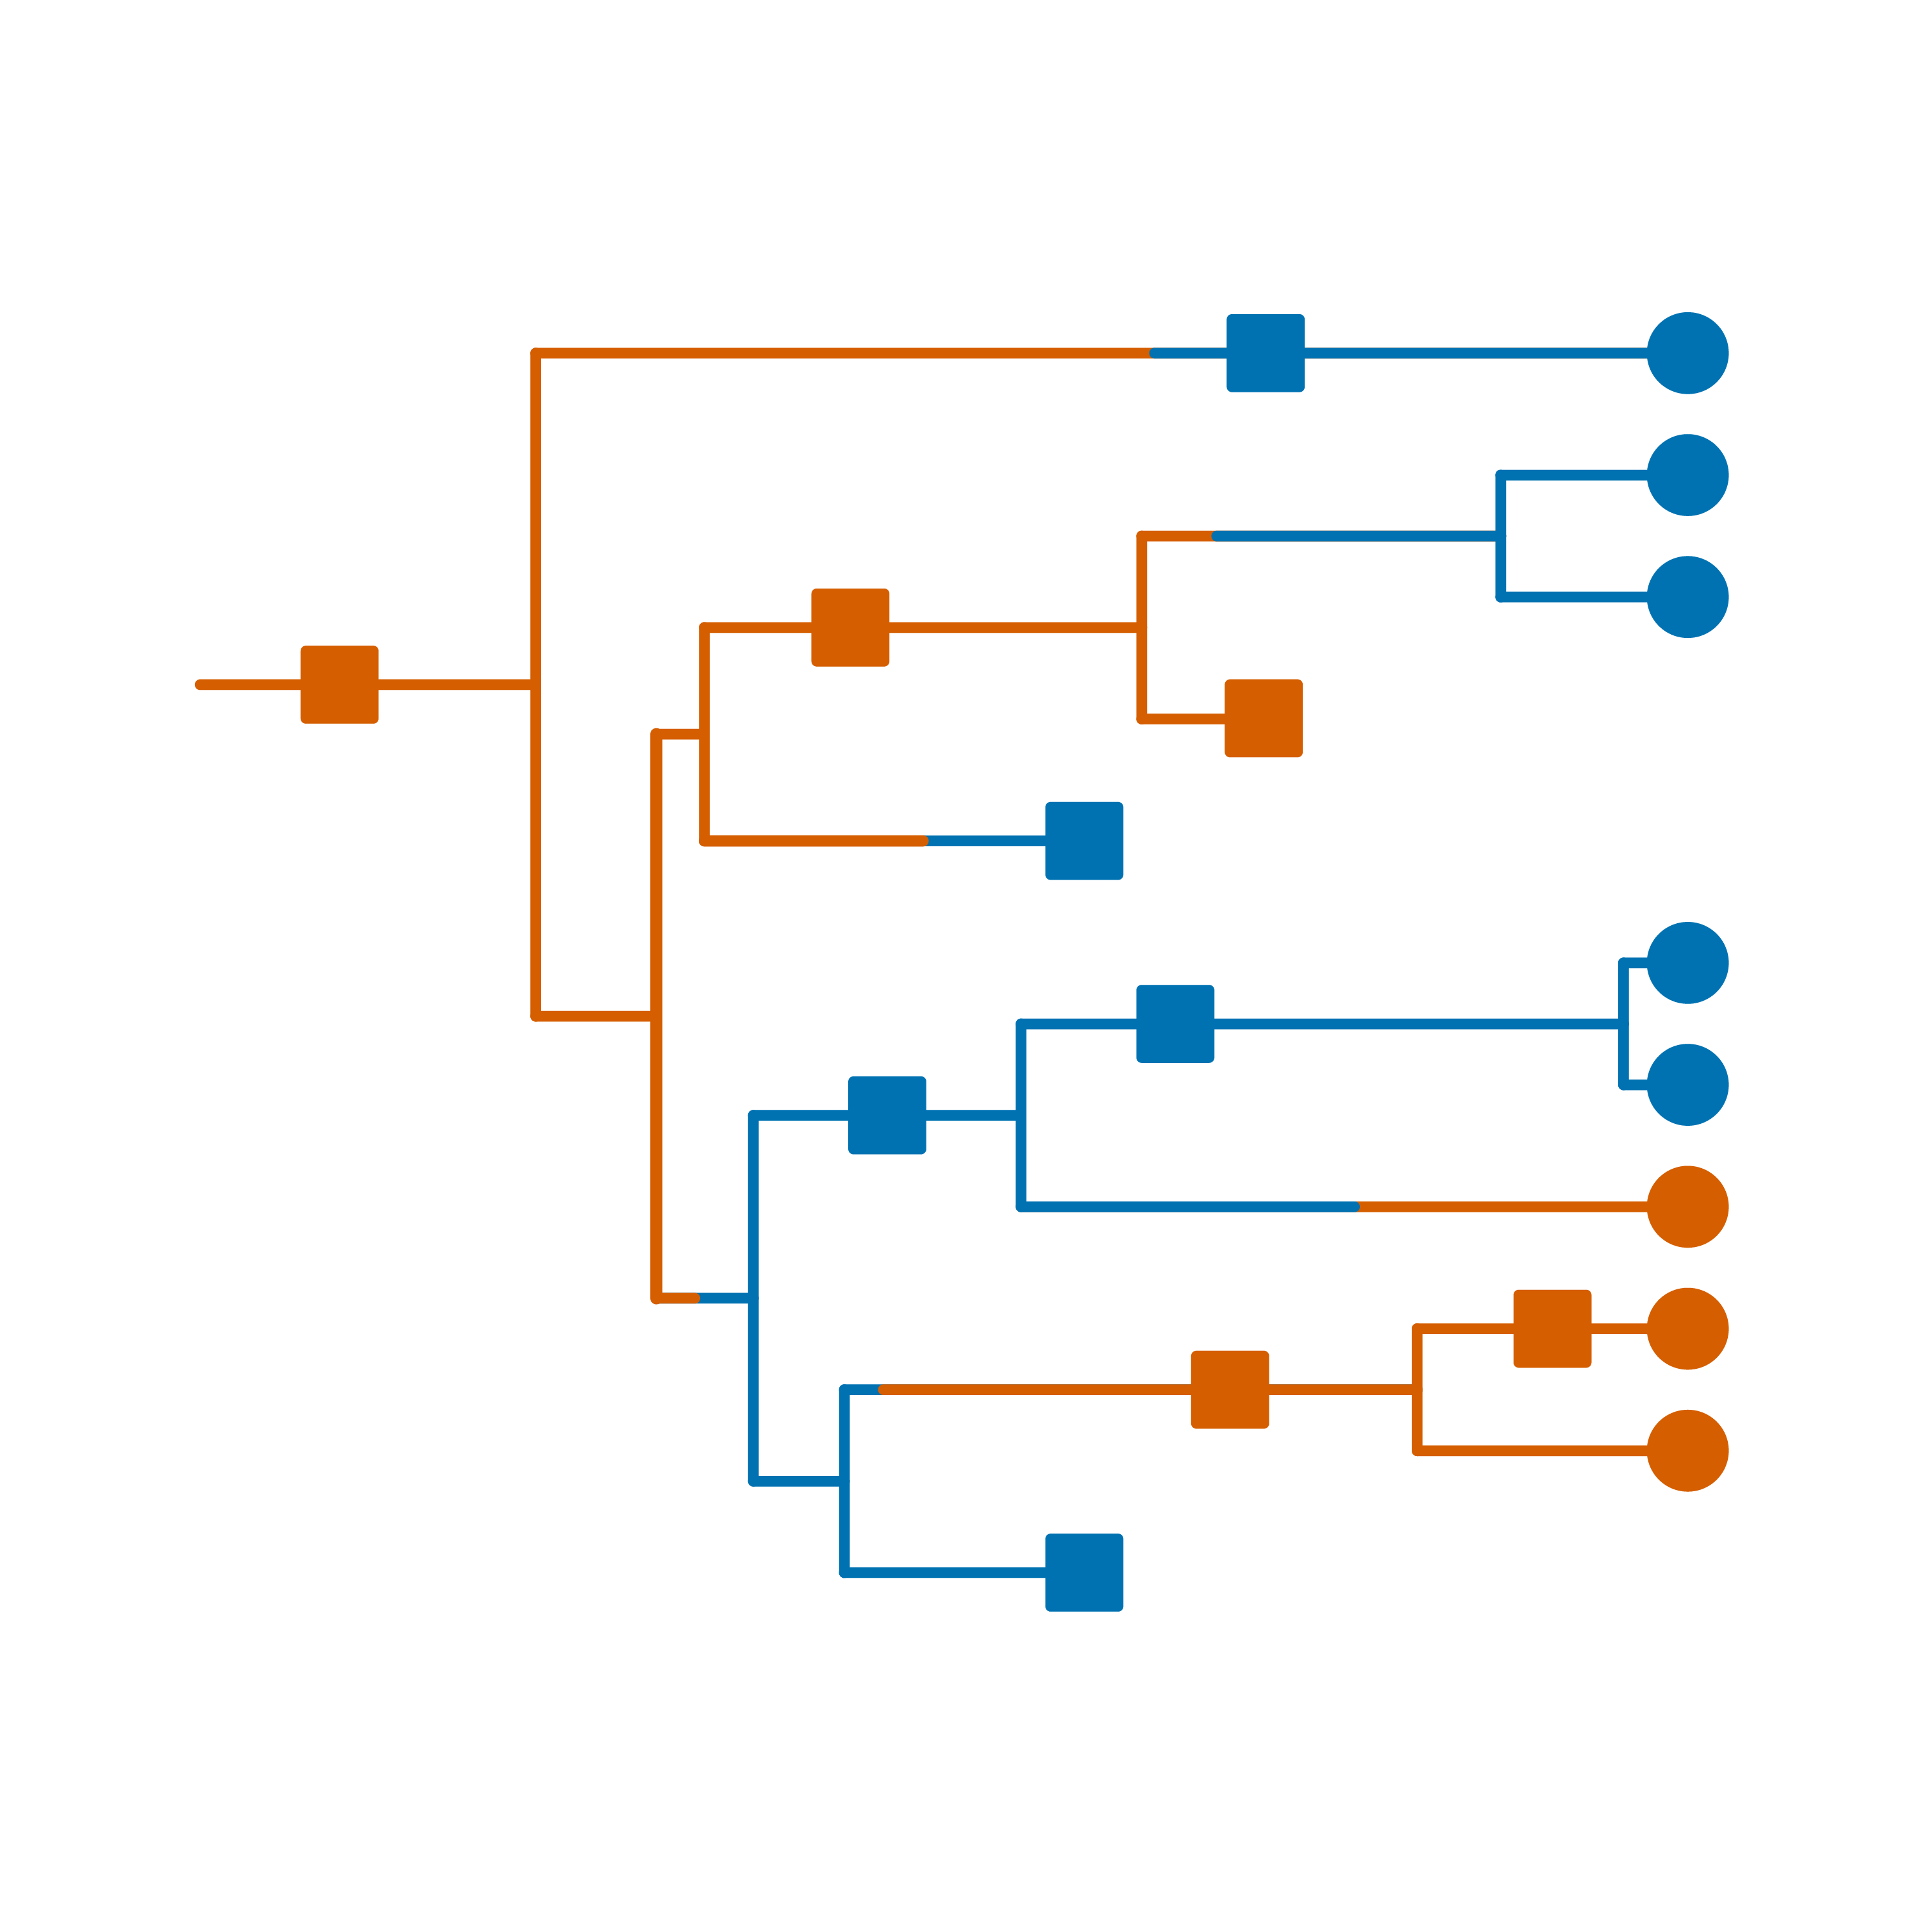
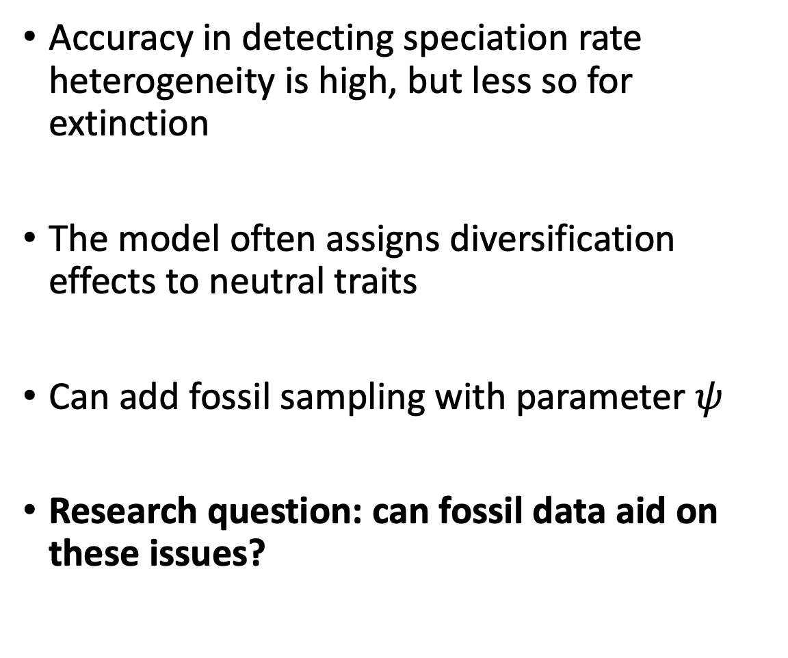
BiSSE accuracy and false positive rates
Accuracy in detecting speciation rate heterogeneity is high, but less so for extinction
The model often assigns diversification effects to neutral traits
Can add fossil sampling with parameter $ψ$
Research question: can fossil data aid on these issues?
Illustration by Lucy Hiegata (https://hiegata.myportfolio.com/)
Rabosky , Daniel L., and Goldberg, Emma E. “Model Inadequacy and Mistaken Inferences of Trait-Dependent Speciation.” Systematic Biology 64.2(2015):340-355
Notes:
The original BiSSE paper showed the model is pretty accurate for detecting differences in speciation, but not extinction
Rabosky & Goldberg later showed that the model might assign a significant effect to a neutral trait, causing a sort of false positive
We can allow for the addition of fossil samples to BiSSE by combining it with the fossilized birth-death model as a sampling parameter psi. FBD has been shown to improve extinction estimates, though it hasn’t been tested in conjunction with BiSSE
The general question for this talk, then, is: can the addition of fossils, i.e. the use of FBD+BiSSE, improve our extinction accuracy and false positive rates?

Slide 6
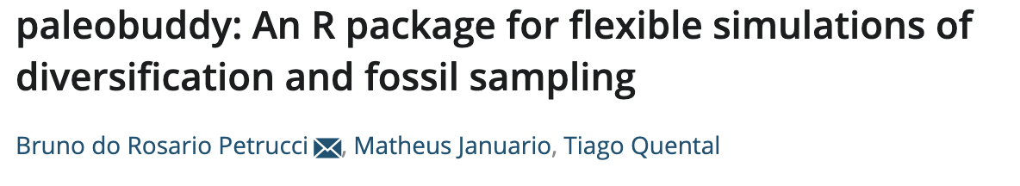
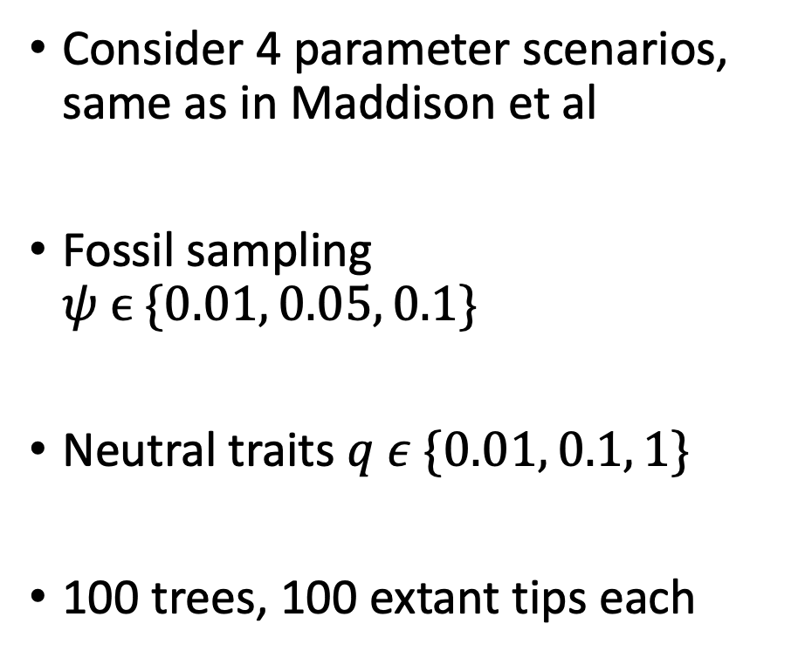
Simulation pipeline
Consider 4 parameter scenarios, same as in Maddison et al
Fossil sampling $ψ ϵ \{0.01, 0.05, 0.1\}$
Neutral traits $q ε \{0.01, 0.1, 1\}$
100 trees, 100 extant tips each
Diagram by Lucy Hiegata (https://hiegata.myportfolio.com/)
Notes:
First we need to simulate data for which we know the true parameters, so we can gauge the estimates. I used the same parameter combinations as in Maddison et al
S1 is a constant (F)BD model, with rates not varying at all based on the evolving trait. S2 has higher speciation for state 1, and S3 higher extinction for state 0 (both cases higher div. for 1). S4 is lower transition rate from 1 to 0 than 0 to 1
Also run fossil sampling simulations with increasing sampling to see how it affects estimates
Finally, run neutral trait simulations with increasing (symmetric) transition rates. Same tests as Rabosky & Goldberg 2015
Low rep number and small trees because of time, which led to some interesting results, but will expand later
Used paleobuddy, my package published in 2022. The trait-dependent stuff is already on github if anyone is interested

Slide 7


Analysis
Analyses ran on RevBayes with the Tensorphylo plugin (development branch)
Bayesian analyses can incorporate prior beliefs and provide a full posterior distribution for parameters
Summarized estimates with 95% coverage probability and mean percent error
Notes:
My analyses were ran on Revbayes with the recent integration with the tensorphylo plugin, which is focused on efficient state-dependent diversification model estimation. All analyses were ran in the Iowa State cluster pronto
Most tests of SSE performance have used maximum likelihood, which only gives a point estimate for results. Bayesian analyses allow us to incorporate prior beliefs, and output a full posterior density for analysis
For this talk we will focus on point estimates though, namely the mean and 95% percentile. Coverage probability means the percent of simulated reps where the true value of the parameter was within the 95% CI for that parameter’s estimates. To get mean percent error, we take the mean of a parameter’s estimates for each rep’s posterior distribution, and average that throughout all reps

Slide 8
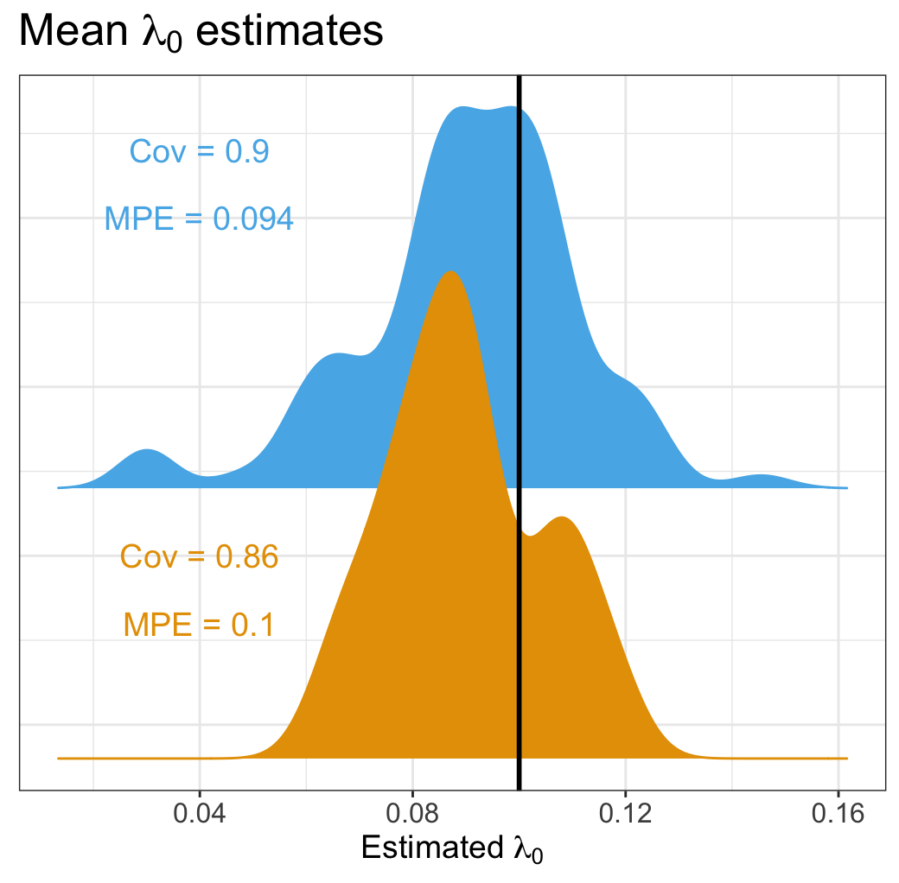
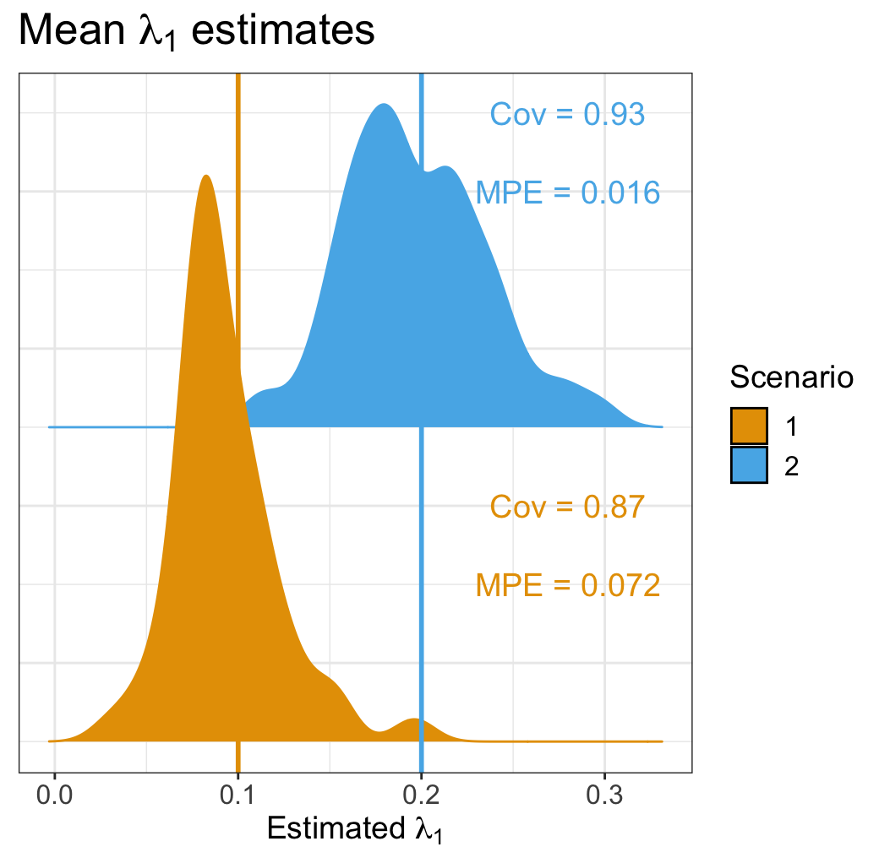
BiSSE: accurate speciation estimates
BiSSE with extant-only trees
High coverage, low error
Notes:
Here we have results for the speciation rate estimates using only BiSSE, i.e. on extant trees (that’s why that nice diagram is up there in the corner)
There are density plots of the mean lambda0 and lambda1 estimates for S1 (no trait-dependence) and S2 (lambda1 is doubled), with vertical lines showing the true values
We see the density of the means more or less centered on the correct value, with good coverage and reasonably low mean percent error, for a 100 rep sample

Slide 9
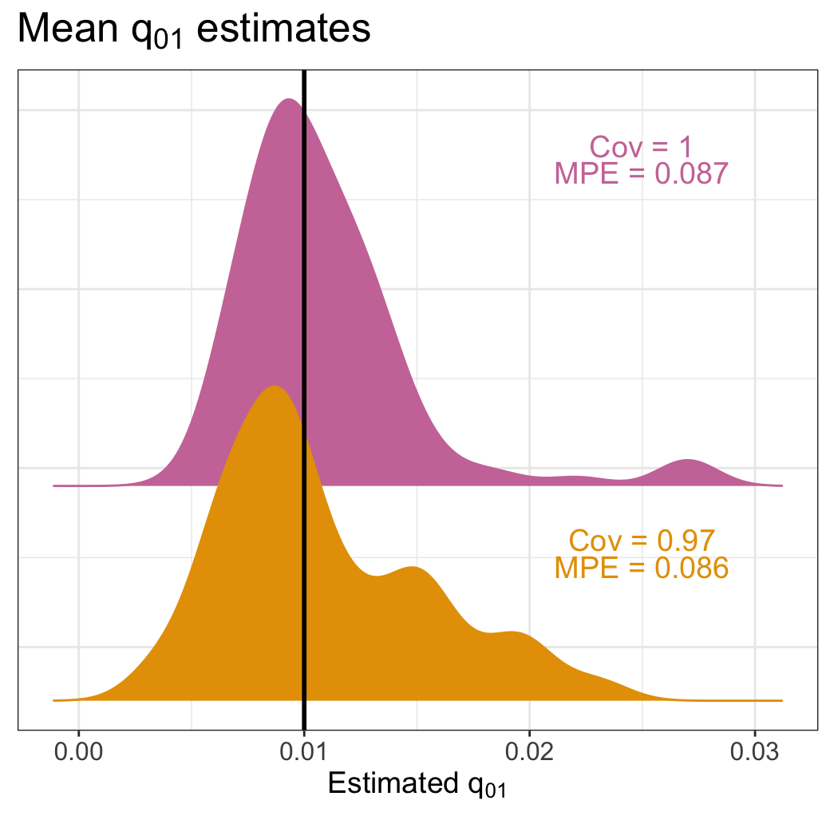
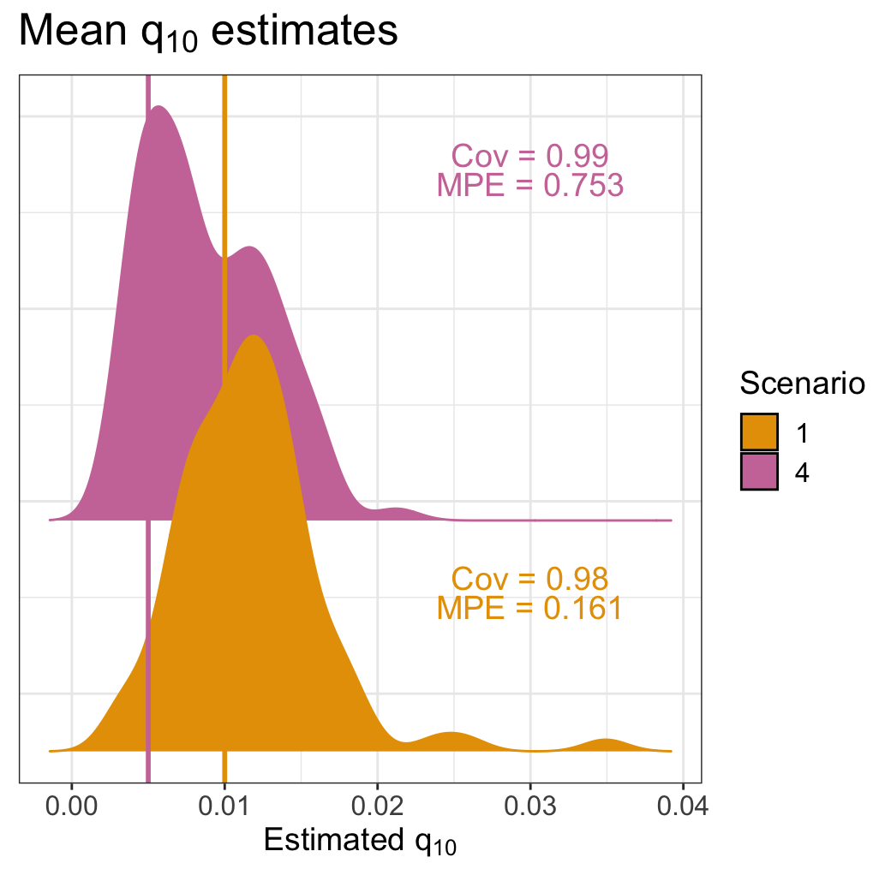
BiSSE: uncertain transition rate estimates
BiSSE with extant-only trees
High coverage, high error
95% interval width 2-4x the true value
Notes:
Results for transition rates are pretty uncertain. In S1 (no trait-dependence) it clearly points to them being symmetric and centers around the correct value
But in S4 (q10 halved), things are pretty uncertain, with high error and even a bimodal implying the model often thinks there's no heterogeneity
The precision is pretty low, with 95% interval width being 2-4x higher than the true value

Slide 10

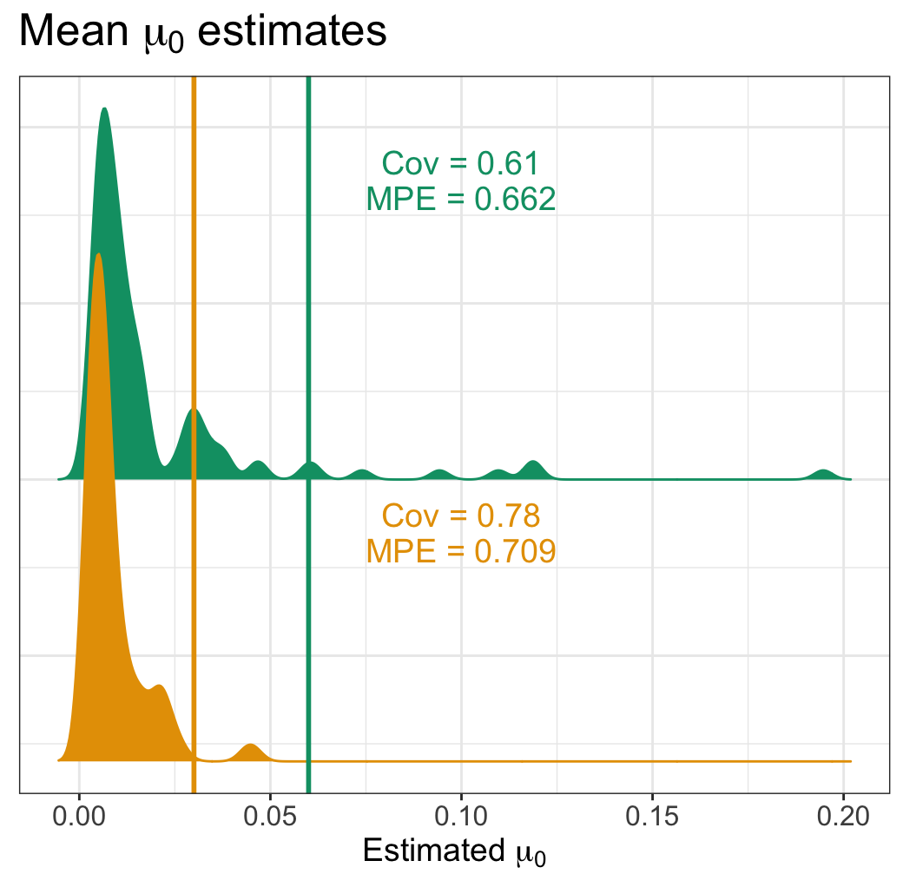
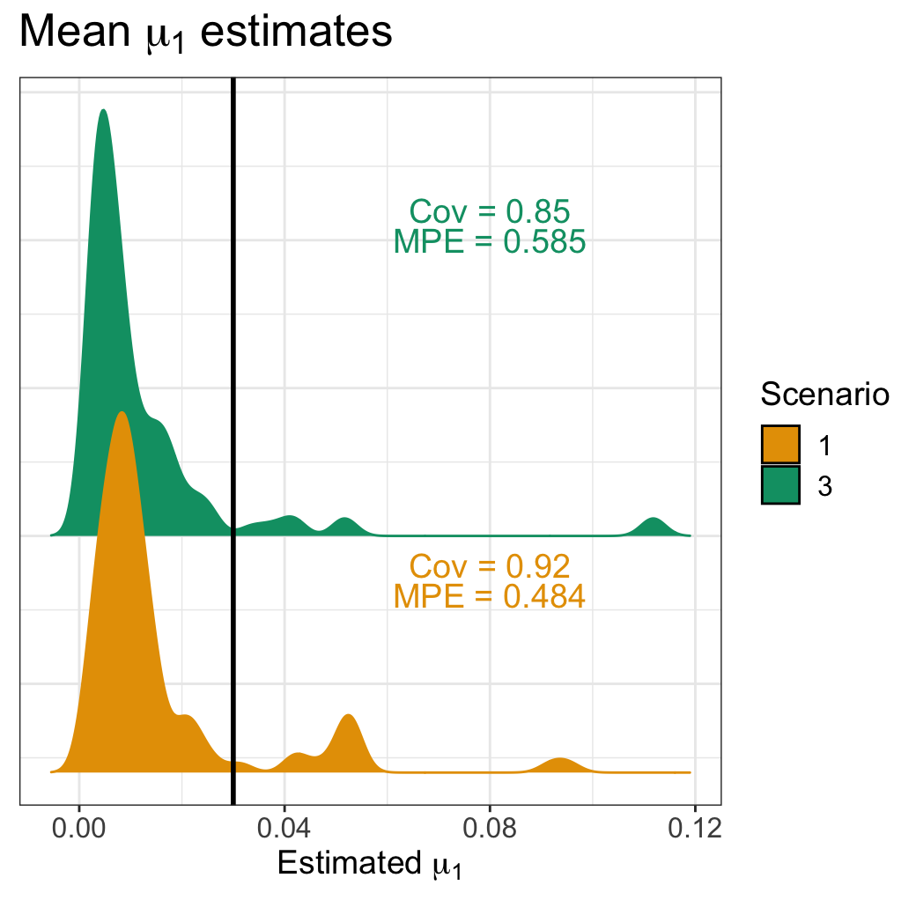
BiSSE: inaccurate extinction rate estimates
BiSSE with extant-only trees
Low-ish coverage, high error
All results agree with Maddison et al 2007
Notes:
For extinction rates, mean estimates clustered around 0, far from the true value
This bias is unclear as of yet, but it might be due to the low size of trees. 100 extant species is not a lot, especially for extinction estimates
Bias aside, these and the previous results all align pretty well with the results of the tests in the original BiSSE paper, Maddison et al 2007

Slide 11
Fossils: speciation rates still accurate
BiSSE + FBD
Higher coverage, lower error
Notes:
Now we look at results when fossil samples are included, with growing fossil sampling rate throughout the three panels
Adding fossil samples has maintained speciation estimate accuracy, with high coverage and low error

Slide 12
Fossils: speciation rates still accurate
BiSSE + FBD
Higher coverage, lower error
Notes:
That’s even clearer in the case of lambda1, when estimates are extremely accurate in differentiating between S1 and S2

Slide 13
Fossils: transition rates still uncertain
BiSSE + FBD
Around the same coverage and error
Notes:
For q01, estimates are still pretty uncertain, and not a lot can be seen in terms of improvement

Slide 14
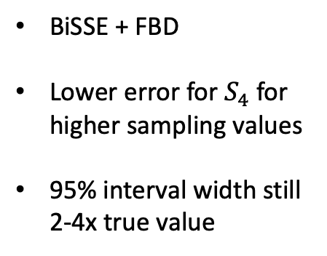
Fossils: transition rates still uncertain
BiSSE + FBD
Lower error for $S_{4}$ for higher sampling values
95% interval width still 2-4x true value
Notes:
For q10 though, error went down significantly for the higher sampling rates, from around 70 to around 30%.
Coverage is maintained. Things are still pretty uncertain, 95% interval is still wide

Slide 15
Fossils: extinction rates are more accurate
BiSSE + FBD
Higher coverage, lower error
Notes:
For the star of the show, extinction! Mu0 estimates got much more accurate, with a lot better coverage and much lower error
The bimodal density indicates sometimes the model tends can't see the heterogeneity, but the higher sampling seems to help with that

Slide 16
Fossils: extinction rates are more accurate
BiSSE + FBD
Higher coverage, lower error
Improved extinction rate accuracy
Notes:
Mu1 shows a similar pattern, again getting more accurate with higher sampling, and less of a tendency to be bimodal
In general, it’s clear that including fossils improves extinction estimate accuracy, without giving up speciation and transition rate estimate accuracy (and maybe improving them)

Slide 17
BiSSE: likely to exhibit false positives
BiSSE with extant-only trees
Results agree with Rabosky & Goldberg 2015
Notes:
To understand the false positive problem, first let’s look at how BiSSE reacts without fossils
In this figure we’re looking at the posterior probability of lambda1 being greater than lambda0. For this cell, No shifts means the generating model had no trait-dependence, and we run BiSSE looking at the effect of the effect trait, i.e. the trait that does affect rates in S2
So speciation was constant. We see the posterior probability is pretty uniform, which makes sense
For these cells, we are looking at increasingly quicker shifts of neutral traits, with increasing symmetrical transition rates, so again we see no patterns in posterior prob
This cell is the case where the effect trait does affect speciation, namely by doubling lambda1, and we see the posterior probability concentrating at 1, as we expected
For the rest of the cells again we’re looking at neutral traits with increasing symmetrical q, so the probs concentrating at 1 is an issue, a false positive result. So BiSSE is pretty good at detecting the real heterogeneity, but it also assigns that heterogeneity to neutral traits. This agrees with Rabosky & Goldberg 2015

Slide 18
Fossils: likely to exhibit false positives
BiSSE + FBD
False positive problems are maintained
Notes:
When we add fossils, we see basically the same pattern, seen here with our high value of fossil sampling (lower values produced the same pattern)
There’s an extra interesting bias forming, where the posterior probability is concentrating around 0 for the no shifts case
We’d expect it to either be flat or concentrate around 0.5 (unsure as of yet lmao), so that’s interesting. I have to do more investigating

Slide 19
Fossils: for extinction, no pattern
BiSSE + FBD
Identifiability is still a problem even with improved estimates
Notes:
For mu, there is no discernible pattern, it seems like even with the improved accuracy it’s not enough for there to be identifiability, even for the real trait case
There is also some interesting bias on the bottom panels, with the 0.5 region being less populated than others, the opposite of what we would expect
Might be due to low rep and tree size, since the simulation might just not have enough signal for the model to estimate correctly
These results can be sensitive to stochastic error in the MCMC, might have to do with simulation signal
Look into some summary stats and patterns to have an idea in the backpocket if someone asks a question
Candidate to cut (could add to conclusions) fossils couldn’t detect the signal

Slide 20
Conclusions
Adding fossil data allows for more accurate extinction estimates, but does not affect false positives
Transition rate estimate accuracy improves, but is still significantly uncertain
Empiricists: use fossils! Extinction estimates really need it
Notes:
As for our conclusions, the general trend seems to be that fossil data does improve the accuracy of extinction rate estimates, but it doesn’t solve our false positive problems
Surprisingly, transition rate estimates improved with fossils, but are still uncertain. It’s possible that the sample size increase helps with that
As most studies using SSE models on empirical data have only used fossils for calibration, this hopefully motivates more empiricists to add fossil data to their analyses when available, as it is really necessary for understanding extinction rates, and therefore getting an accurate picture of diversification

Slide 21
Ongoing work
Increase tree size and number of replicate simulations for better precision
Consider false positive problems with extinction rate—might need more signal from simulations
Test how these results compare to patterns in Beaulieu & O’Meara 2023
Extend this entire pipeline to test HiSSE (currently running)
Beaulieu, Jeremy M., O’Meara, Brian C. “Fossils Do Not Substantially Improve, and May Even Harm, Estimates of Diversification Rate Heterogeneity.” Systematic Biology 72.1(2023):50–56
Notes:
For future, or rather ongoing, work, the first thing to do is to increase our sample size to gauge which patterns seen in this study are due to problems with signal from the simulation and low sample size
This year a paper came out that put into question whether including fossils improve diversification estimates, in particular when the true generating model is not within the range of tested models. Those results don’t directly contradict ours, but I am interested in seeing how our results compare
Currently I’m also extending this entire pipeline to HiSSE, BiSSE with the possibility of hidden states

Slide 22








Thank you!
The Heath lab at ISU
Funding:
PhD committee:
Prof. Dean Adams
Prof. Haldre Rogers
Prof. Jeanne Serb
Prof. Graham Slater
Other collaborators:
Dr. Joëlle Barido-Sottani
Dr. Walker Pett
Dr. Jordan Satler
Prof. Tiago Quental
Matheus Januário
Elizabeth Glynne Boenigk
EEB
Notes:
l

Slide 23
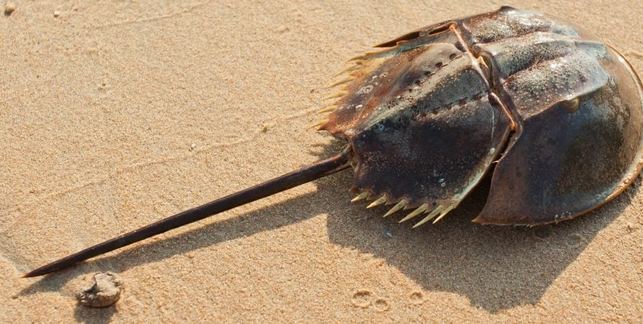



Questions?
petrucci@iastate.edu
brpetrucci

Slide 24
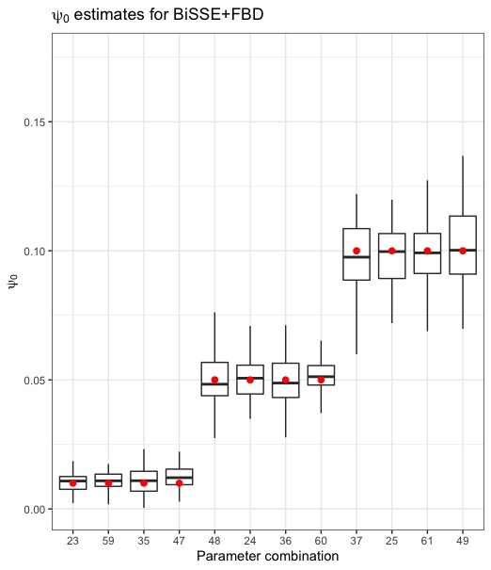

Slide 25
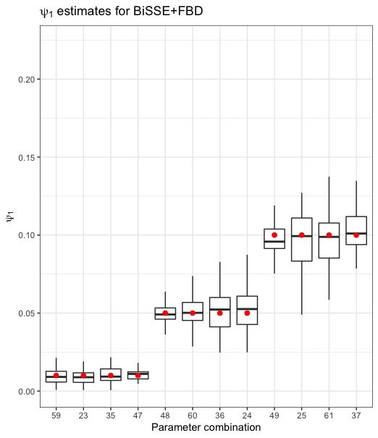

Slide 26
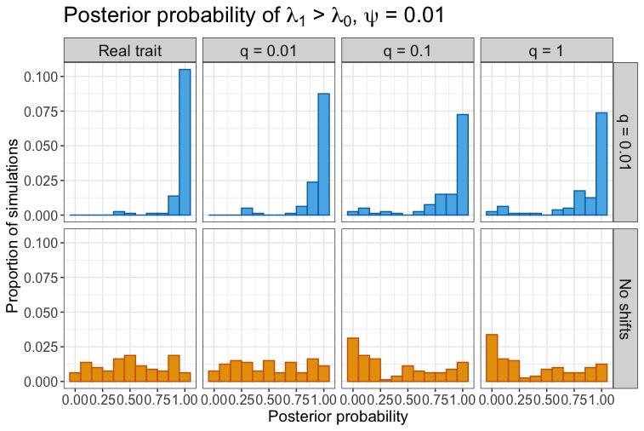

Slide 27
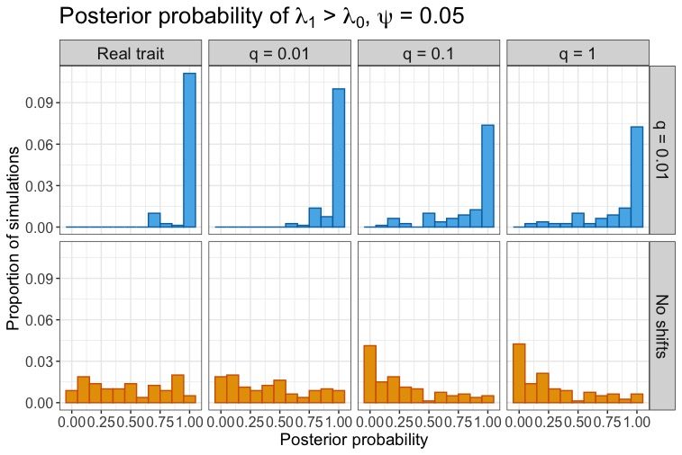

Slide 28
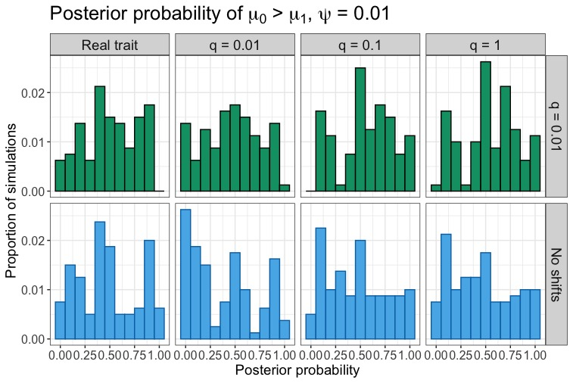

Slide 29
